Slide 1

Tuxedo Cat Classification
A Supervised Machine Learning Project
David Wullimann
2024-03-11

Slide 2
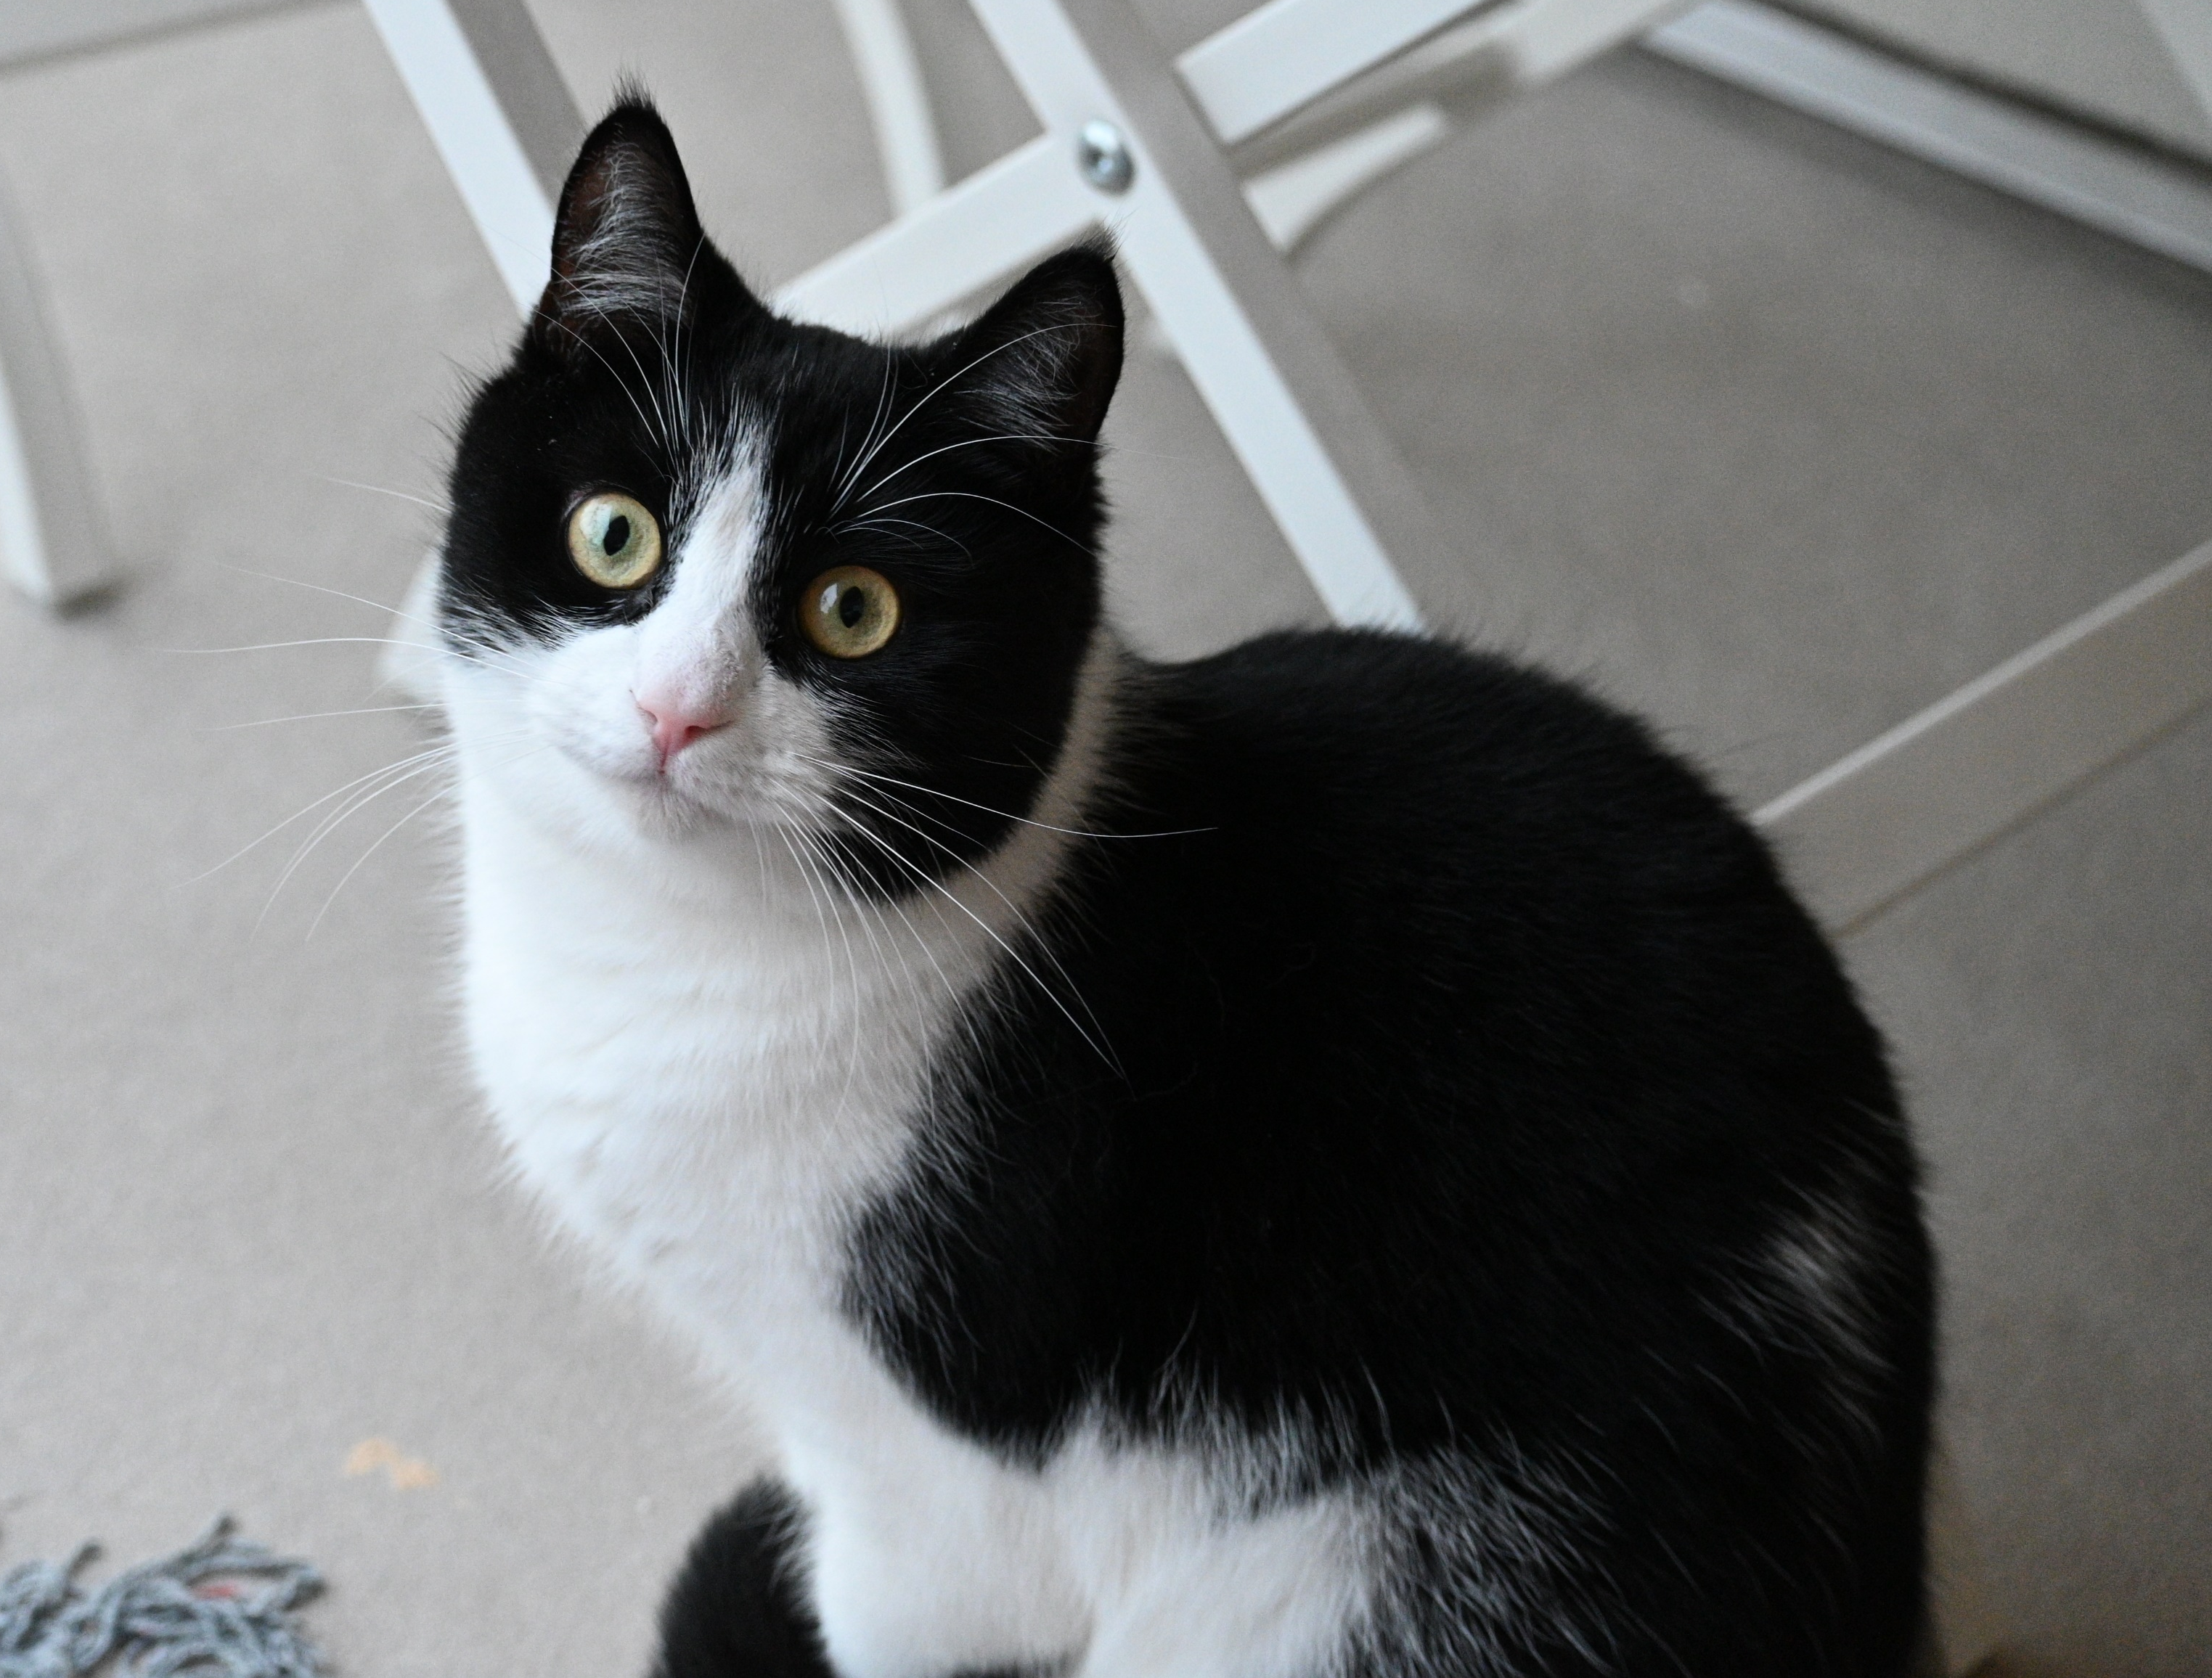
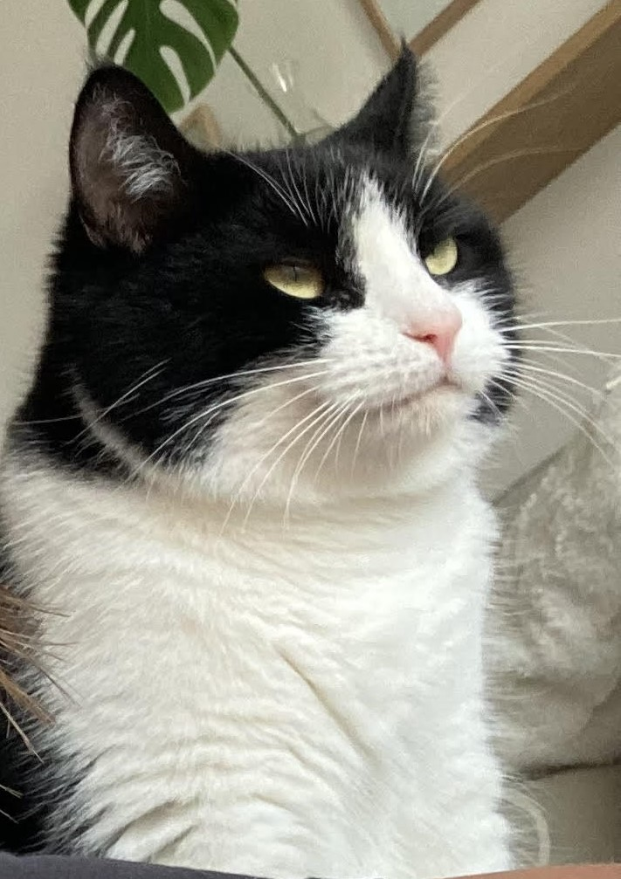
What is a tuxedo cat?
Meet Flora.

Slide 3
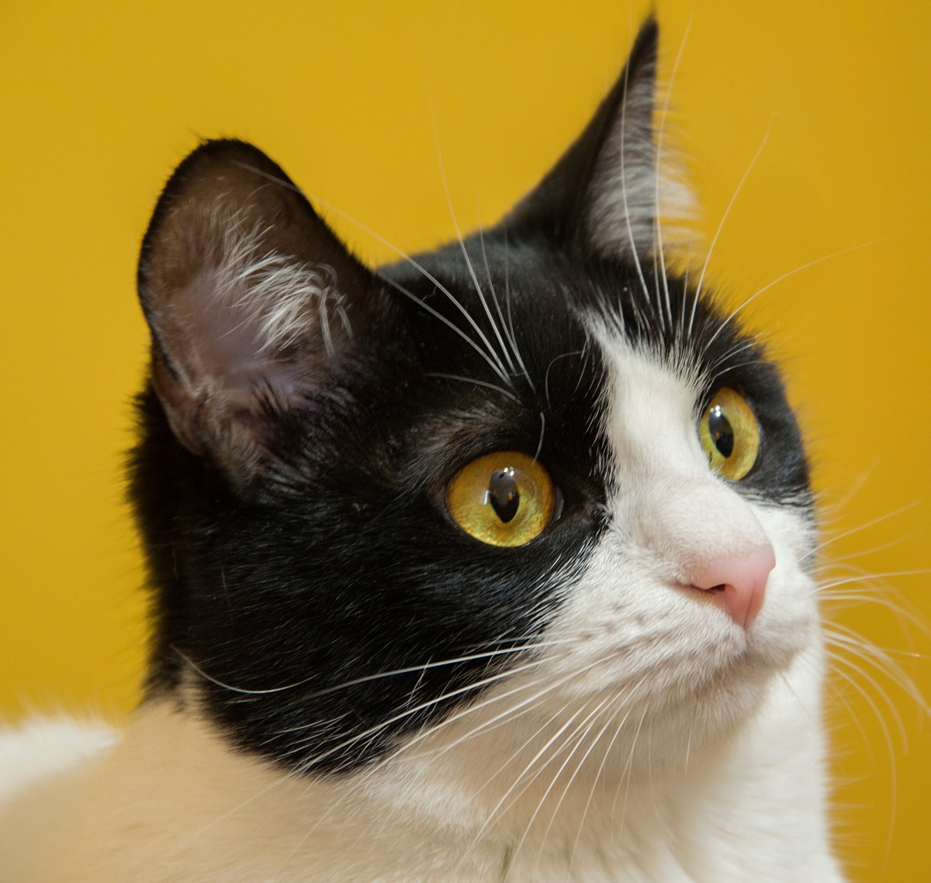
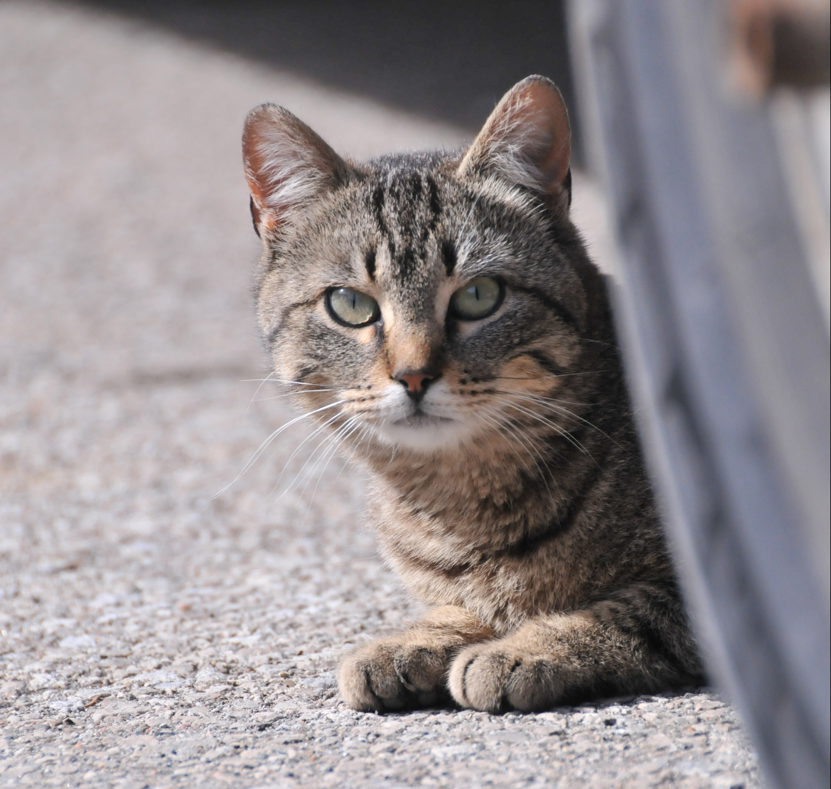
Tuxedo Cat clf
Tuxedo cat or other?
140 images evenly split with manual labels (me)
Tuxedo Cat
Not Tuxedo Cat

Slide 4
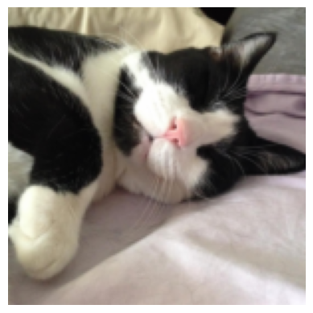
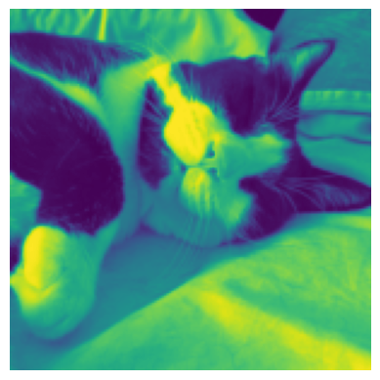
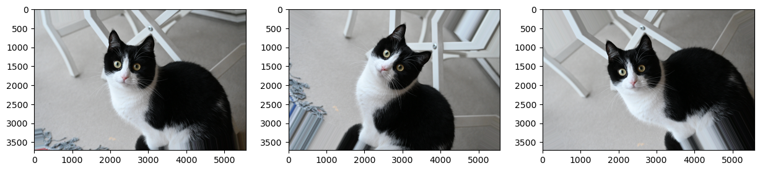
Image augmentation
Rescale, grayscale
Rotation, brightness, shifts, zoom, flips
Convert images to np.array and perform standard scale
np.array(1120, 67501)
140 images → 1120

Slide 5
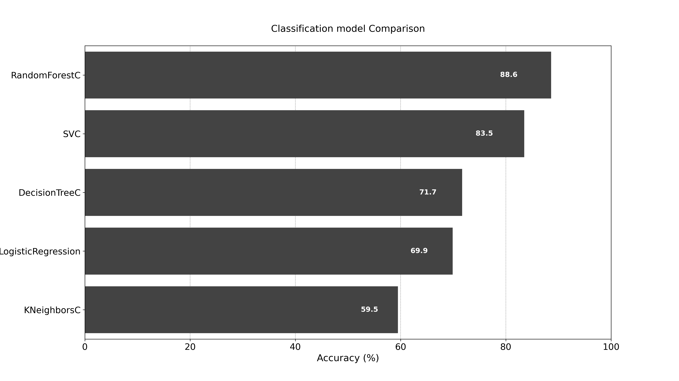
Model selection

Slide 6
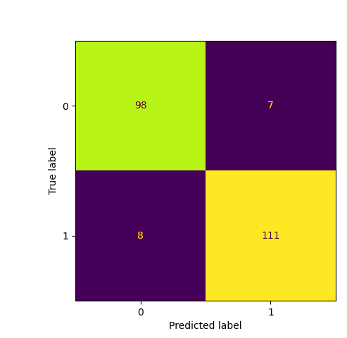
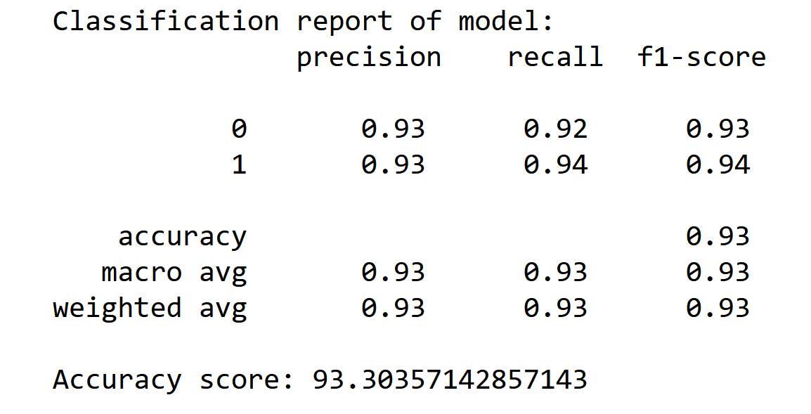
RandomForest clf

Slide 7
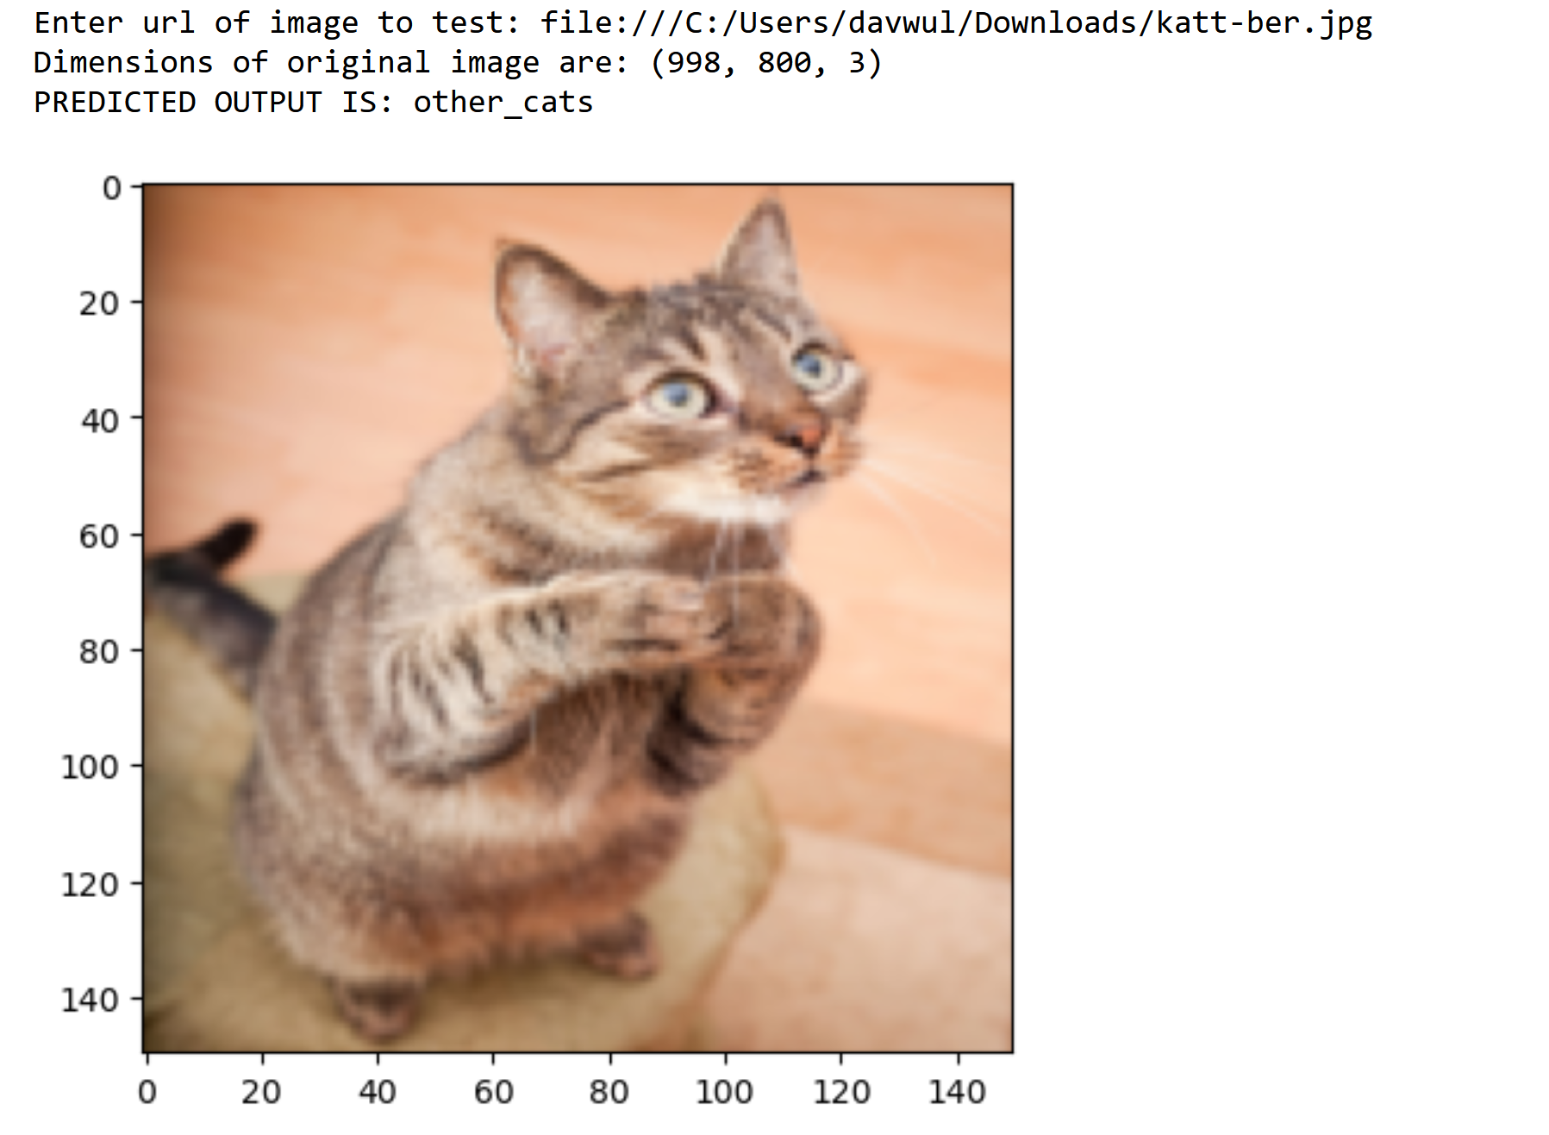
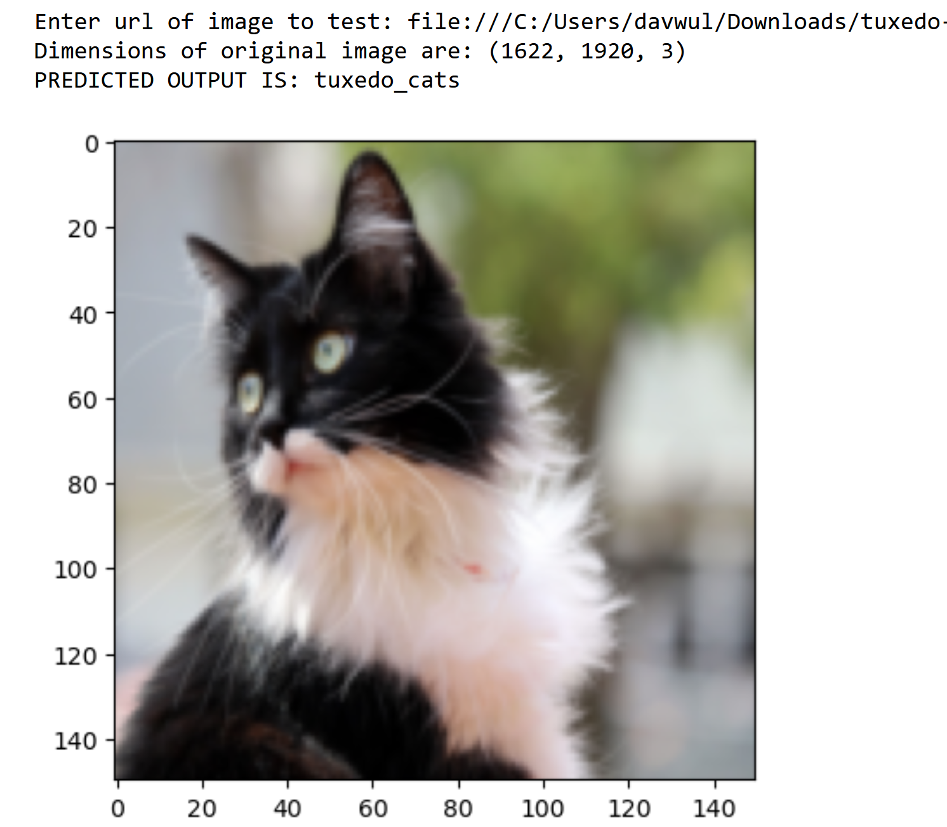
Validation

